Slide 1
Start-up Performance of Web Applications
Qi Sun

Slide 2
PPT模板下载：www.1ppt.com/moban/ 行业PPT模板：www.1ppt.com/hangye/
节日PPT模板：www.1ppt.com/jieri/ PPT素材下载：www.1ppt.com/sucai/
PPT背景图片：www.1ppt.com/beijing/ PPT图表下载：www.1ppt.com/tubiao/
优秀PPT下载：www.1ppt.com/xiazai/ PPT教程： www.1ppt.com/powerpoint/
Word教程： www.1ppt.com/word/ Excel教程：www.1ppt.com/excel/
资料下载：www.1ppt.com/ziliao/ PPT课件下载：www.1ppt.com/kejian/
范文下载：www.1ppt.com/fanwen/ 试卷下载：www.1ppt.com/shiti/
教案下载：www.1ppt.com/jiaoan/ PPT论坛：www.1ppt.cn
CONTENTS
01
Backgrounds
02
Facts and Strategies
03
Summary

Slide 3
PART
ONE
PPT模板下载：www.1ppt.com/moban/ 行业PPT模板：www.1ppt.com/hangye/
节日PPT模板：www.1ppt.com/jieri/ PPT素材下载：www.1ppt.com/sucai/
PPT背景图片：www.1ppt.com/beijing/ PPT图表下载：www.1ppt.com/tubiao/
优秀PPT下载：www.1ppt.com/xiazai/ PPT教程： www.1ppt.com/powerpoint/
Word教程： www.1ppt.com/word/ Excel教程：www.1ppt.com/excel/
资料下载：www.1ppt.com/ziliao/ PPT课件下载：www.1ppt.com/kejian/
范文下载：www.1ppt.com/fanwen/ 试卷下载：www.1ppt.com/shiti/
教案下载：www.1ppt.com/jiaoan/ PPT论坛：www.1ppt.cn
Background

Slide 4
Why start-up performance matters
53% of mobile site visits are abandoned if the pages take longer than 3 seconds to load.
The average load time for mobile sites is 19 seconds on 3G connections.
Hyper-
connected
减少
环境污染
——Webpagetest.org, February 2016

Slide 5
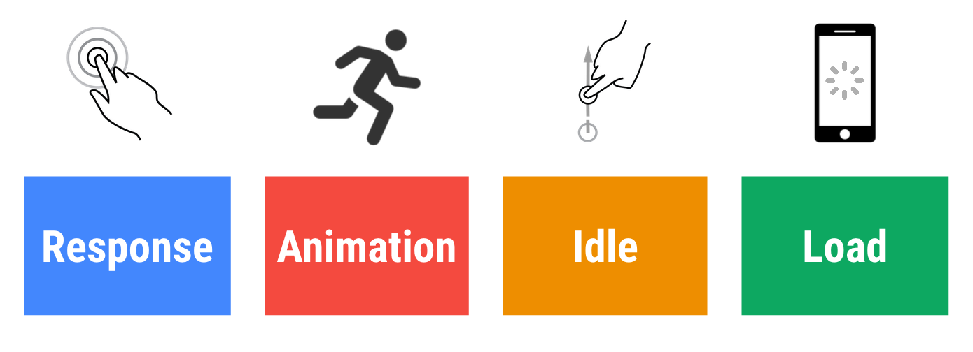
How to measure performance: RAIL
https://developers.google.com/web/fundamentals/performance/rail

Slide 6
PART
TWO
Facts & Strategies

Slide 7
Facts that influence start-up performance
Network
Fetch files and resources from server to user.
Scripting
Parse, compile & execute JavaScript.
rendering
Display items on user’s screen.

Slide 8
Network
45% of mobile connections occurred over 2G worldwide.
75% of connections occurred on either 2G or 3G.
Hyper-
connected
减少
环境污染
——GSMA, https://www.gsma.com/mobileeconomy/
Notes:
这里讲清更新策略

Slide 9
Strategies
Minify your code. (Uglify)
Compress the files heavily. (Gzip)
Remove unused code. (code-coverage tool: Google Chrome’s Developer Tool, uncss)
Preload all resources in the main document, or even better, preload with HTTP/2.0.

Slide 10
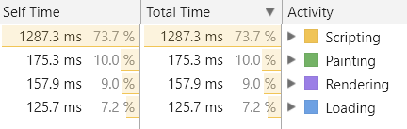
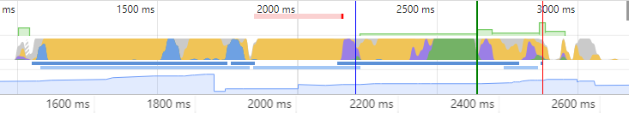
Scripting
Test on Course Website with Chrome’s Developer Tools
The most time-costing task for your browser!

Slide 11
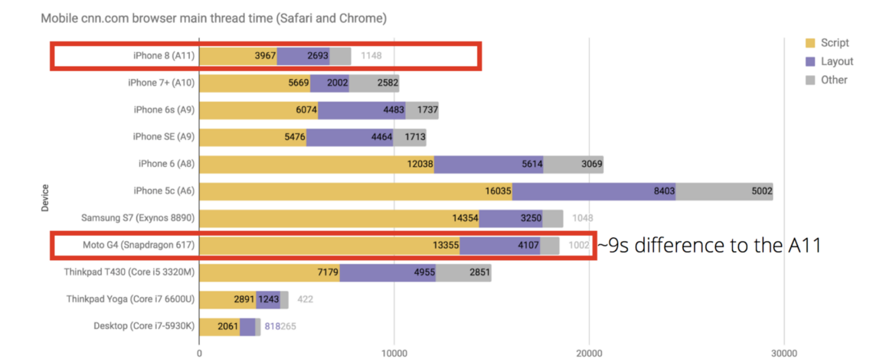
Scripting
Loading time is acceptable, but how about other devices?
global average cost this year is only 245.1$
https://www.statista.com/statistics/484583/global-average-selling-price-smartphones/
https://medium.com/dev-channel/the-cost-of-javascript-84009f51e99e

Slide 12
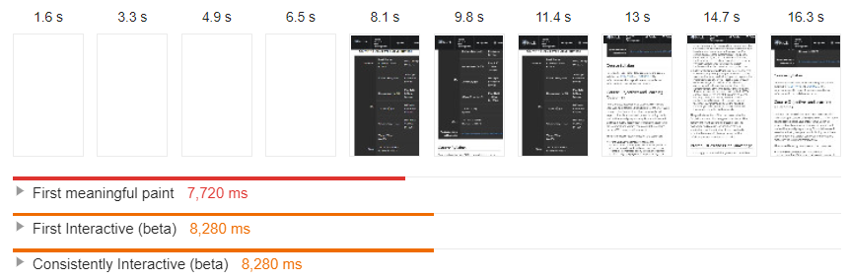
Scripting
Loading time is acceptable, but how about other devices?
Test of course website, on simulated Nexus 5X with Chrome

Slide 13
Strategies
Code-splitting
Progressive bootstrapping
Divide codes into small chunks with different priority
Load lazily and unlock more when arriving
Method 1
Method 3
Method 2
Method 4
Less Script
AOT Compilation
Obviously less script will need less time to process
Convert code into efficient JavaScript before download

Slide 14
Rendering: Server-side VS Client-side
Server Side Rendering
Good choice for static, less interactive pages
Convenient for search engine to parse
Client Side Rendering
More efficient for webpages with complex features
Hard to handle: bundling, transpiling, linting, cache bursting……
No worry, frameworks will do it for us!!

Slide 15
PART
THREE
Summary

Slide 16
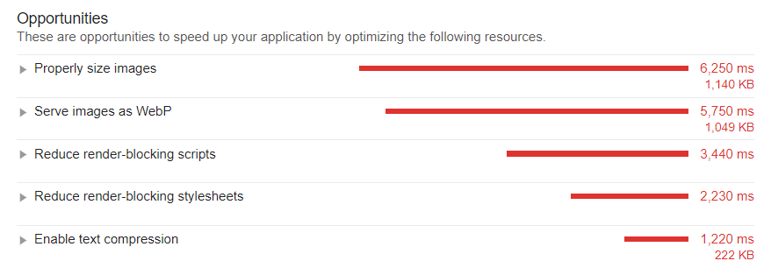
Summary
Network, Scripting, Rendering

Slide 17
THANKS

